Slide 1

Amazon Sales Analysis
By Md Shoaib

Slide 2

Introduction
Welcome to the presentation on Analyzing
Amazon Sales Trends.
In This we are going to analyze the sales trend of Amazon Based on different insights.

Slide 3
Details of Data
Region Wise Sales Revenue
Region Wise Sales Profit
Top 10 Country sales profit wise
Lowest 10 country sales profit wise
Sales trend on daily basis
Sales trend on monthly basis
Sales trend on year
Sales trend based on category

Slide 4
Problem Statement
Sales management has gained importance to meet increasing competition and the need for improved methods of distribution to reduce cost and to increase profits. Sales management today is the most important function in a commercial and business enterprise. Find key metrics and factors and show the meaningful relationships between attributes.

Slide 5
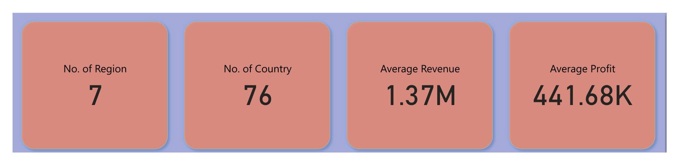
Main KPI’s
Number of Region
Number of Countries
Average Revenue
Average Profit

Slide 6
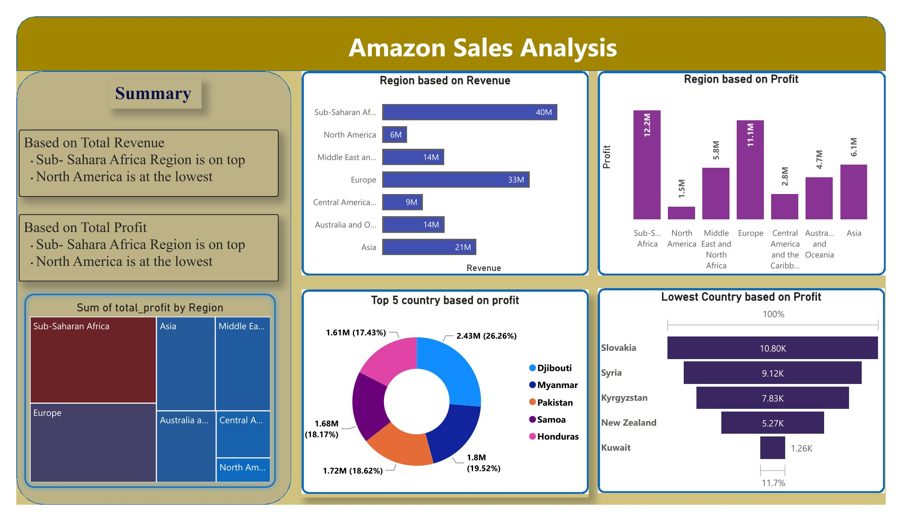

Slide 7

Amazon Sales Analysis based on Revenue and Profit
Understanding consumer behavior is
crucial for interpreting sales trends.
Analyzing factors such as purchase
frequency, demographics, and shopping
preferences can unveil valuable insights.
If we see the dashboard we see that in both the terms weather it is profit or revenue
Sub-Sahara African Region is in top
North America is at lowest

Slide 8
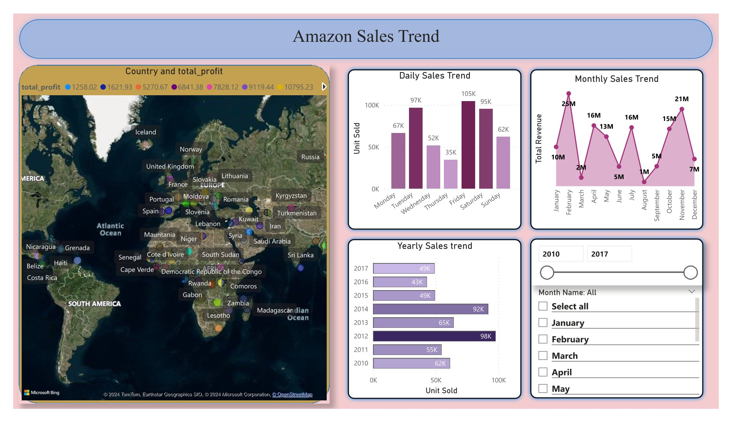

Slide 9

Timely Sales Trend
Watching a competitive analysis
provides a comprehensive view of
Amazon's sales landscape. Identifying
competitor strategies and market
positioning can offer valuable insights for
enhancing sales performance.
Sales Trend based on Weekly, Monthly and yearly is shown

Slide 10

Conclusion
All the useful insights is shown in both graphic terms and in theoretical term

Slide 11

Thanks!

